Slide 1
Database Design
Zev Feldberger

Slide 2

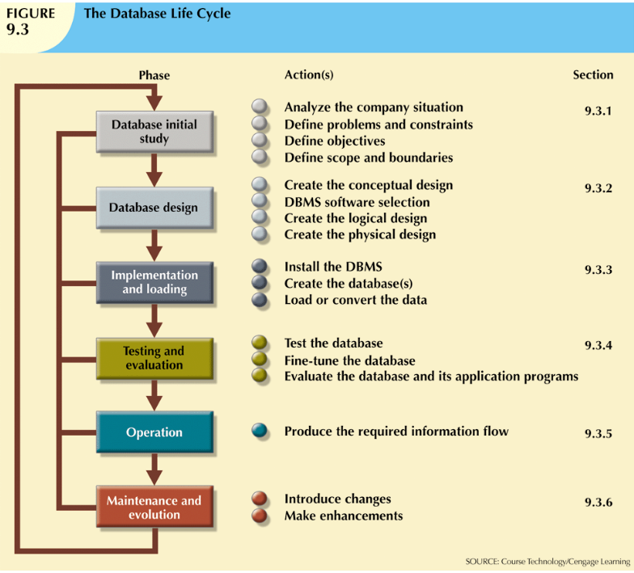
DBLC - Database Life cycle
Notes:
Agile methodology – User Stories, Iterations, Sprints, Scrum, etc
Preliminary design
Detailed design
UML
Activity diagrams
Use case diagrams
Class diagrams

Slide 3
Structured vs. Unstructured Data
Structured data is easily searchable by basic algorithms. Examples include spreadsheets and data from machine sensors. Unstructured data is more like human language. It doesn't fit nicely into relational databases like SQL, and searching it based on the old algorithms ranges from difficult to completely impossible

Slide 4
Structured vs. Unstructured Data
The term structured data generally refers to data that has a defined length and format for big data. Examples of structured data include numbers, dates, and groups of words and numbers called strings. ... Structured data is the data you're probably used to dealing with. It's usually stored in a database.
Unstructured data is essentially everything else. Unstructured data is not structured via pre-defined data models or schema. It may be textual or non-textual, and human- or machine-generated.
Examples of Unstructured Data. Unstructured data files often include text and multimedia content. Examples include e-mail messages, word processing documents, videos, photos, audio files, presentations, webpages and many other kinds of business documents.

Slide 5
Top-down vs. Bottom-up design and centralized vs. decentralized design
The top-down design method starts from the general and moves to the specific. In other words, you start with a general idea of what is needed for the system and then work your way down to the more specific details of how the system will interact. This process involves the identification of different entity types and the definition of each entity’s attributes.
The bottom-up approach begins with the specific details and moves up to the general. This is done by first identifying the data elements (items) and then grouping them together in data sets. In other words, this method first identifies the attributes, and then groups them to form entities.

Slide 6
Top-down vs. Bottom-up design and centralized vs. decentralized design
Centralized design is most productive when the data component is composed of a moderately small number of objects and procedures. The design can be carried out and represented in a somewhat simple database. Centralized design is typical of a simple or small database and can be successfully done by a single database administrator or by a small design team. This person or team will define the problems, create the conceptual design, verify the conceptual design with the user views, and define system processes and data constraints to ensure that the design complies with the organizations goals. That being said, the centralized design is not limited to small companies. Even large companies can operate within the simple database environment
Decentralized design might best be used when the data component of the system has a large number of entities and complex relations upon which complex operations are performed. This is also likely to be used when the problem itself is spread across many operational sites and the elements are a subset of the entire data set. In large and complex projects a team of carefully selected designers are employed to get the job done. This is commonly accomplished by several teams that work on different subsets or modules of the system. Conceptual models are created by these teams and compared to the user views, processes, and constraints for each module. Once all the teams have completed their modules they are all put aggregated into one large conceptual model.

Slide 7
First Normal Form
First normal form is very simple. A table scheme is said to be in first normal form if the attribute values are indivisible. To illustrate, we consider the question of including all the authors of a book in a single attribute, called Authors. Here is an example entity:
Notes:
Codd
7 degrees of normalization

Slide 8
First Normal Form
Book
ISBN | Title | Publisher | Author
0-55-123456-9 | Main Street | Small House | Jones, H. and Smith, K.

Slide 9
First Normal Form
Since the table scheme in this case allows more than one author name for the Authors attribute, the scheme is not in first normal form. Indeed, one of the obvious problems with the Authors attribute is that it is impossible to sort the data by individual author name. It is also more difficult to, for instance, prepare a mailing label for each author, and so on.
Attributes that allow only indivisible values are said to be scalar attributes or atomic attributes. By contrast, an attribute whose values can be, for example, a list of items (such as a list of authors) is said to be a structured attribute. Thus, a table scheme is in first normal form if all of its attributes are atomic. Good database design almost always requires that all attributes be atomic, so that the table scheme is in first normal form.
In general, making the adjustments necessary to ensure first normal form is not hard, and it is a good general rule that table schemes should be put in first normal form. However, as with the other normal forms (and even more so the higher up we go) each situation must be considered on its own merits. For instance, a single field might be designed to hold a street address, such as 1333 Bessemer Street. Whether the house number and the street name should be separated into distinct attributes is a matter of context. Put another way, whether or not a street address is atomic depends upon the context. If there is reason to manipulate the street numbers apart from the street names, then they should certainly constitute their own attribute. Otherwise, perhaps not.

Slide 10
First Normal Form
Book
ISBN | Title | Publisher
0-55-123456-9 | Main Street | Small House
0-55-123456-7 | New Stuff | Big House
Book Authors
ISBN | Author Name
0-55-123456-9 | 1
0-55-123456-9 | 2
0-55-123456-7 | 1
Authors
ID | Author Name | Age | Gender
1 | Jones, H. | 34 | M
2 | Smith, K. | 56 | M

Slide 11
First Normal Form
Customer
Customer ID | First Name | Surname | Telephone Number
123 | Robert | Ingram | 555-861-2025
456 | Jane | Wright | 555-403-1659 555-776-4100
789 | Maria | Fernandez | 555-808-9633
Customer Name
Customer ID | First Name | Surname
123 | Robert | Ingram
456 | Jane | Wright
789 | Maria | Fernandez
Customer Telephone Number
Customer ID | Telephone Number
123 | 555-861-2025
456 | 555-403-1659
456 | 555-776-4100
789 | 555-808-9633

Slide 12
Second Normal Form
A table scheme is in second normal form, or 2NF, if all of the strictly informational attributes (attributes that do not belong to any key) are attributes of the entities in the table scheme, and not of some other class of entities. In other words, the informational attributes provide information specifically about the entities in this entity class and not about some other entities.
Let us illustrate with an example.
Consider a simplified table scheme designed to store house addresses. One possibility is:

Slide 13
Second Normal Form
House Addresses
City | Address | Sq. footage | House Color | City Population
Lakewood | 45 Lexington Ave | 2,475 | Blue | 35,000
The City-Population attribute is out of place here, because it is an attribute of cities, not house addresses.
More specifically, City-Population is strictly an informational attribute (not for identification of houses)
but it gives information about cities, not house addresses. Thus, this table scheme is not in second normal form.

Slide 14
Second Normal Form
Electric Toothbrush Models
Manufacturer | Model | Model Full Name | Manufacturer Country
Forte | X-Prime | Forte X-Prime | Italy
Forte | Ultraclean | Forte Ultraclean | Italy
Dent-o-Fresh | EZbrush | Dent-o-Fresh EZbrush | USA
Kobayashi | ST-60 | Kobayashi ST-60 | Japan
Hoch | Toothmaster | Hoch Toothmaster | Germany
Hoch | X-Prime | Hoch X-Prime | Germany
Electric Toothbrush Models
Manufacturer | Model | Model Full Name
Forte | X-Prime | Forte X-Prime
Forte | Ultraclean | Forte Ultraclean
Dent-o-Fresh | EZbrush | Dent-o-Fresh EZbrush
Kobayashi | ST-60 | Kobayashi ST-60
Hoch | Toothmaster | Hoch Toothmaster
Hoch | X-Prime | Hoch X-Prime
Electric Toothbrush Manufacturers
Manufacturer | Manufacturer Country
Forte | Italy
Dent-o-Fresh | USA
Kobayashi | Japan
Hoch | Germany

Slide 15
Second Normal Form
Books
Title | Publisher ID | Author ID | Price | Author Address
The Great Book | 8 | 3 | 12.99 | 45 Lexington Ave
Consider the following table scheme, and assume for the purposes of illustration that, while there may be many books with the same title, no two of them have the same publisher and author:
{Title,PubID,AuID,Price,AuthorAddress}
Thus, {Title, PubID, AuID} is the only key. Now, AuthorAddress does not belong to any key, but it depends upon {AuID}, which is a proper subset of the key, in symbols:
{AuID} --> {AuthorAddress}
Hence, this table scheme is not in second normal form. In fact, AuthorAddress is not a piece of information about the entities modeled in the table scheme (i.e., books), but rather about authors. Of course, we could remove the AuthorAddress attribute to bring the table scheme into second normal form. (If each publisher charged a single price for all of its books, then Price would also cause a violation of second normal form, but this is not the case, of course.)

Slide 16
Third Normal Form
Primary Key (PK) | Column A | Column B | Transitive Dependence?
PersonID | FirstName | LastName | No, In Western cultures a person’s last name is based on their father’s LastName, whereas their FirstName is given to them.
PersonID | BodyMassIndex | IsOverweight | Yes, BMI over 25 is considered overweight.It wouldn’t make sense to have the value IsOverweight be true when the BodyMassIndex was < 25.
PersonID | Weight | Sex | No:There is no direct link between the weight of a person and their sex.
VehicleID | Model | Manufacturer | Yes:Manufacturers make specific models. For instance, Ford creates the Fiesta; Toyota manufacturers the Camry.

Slide 17
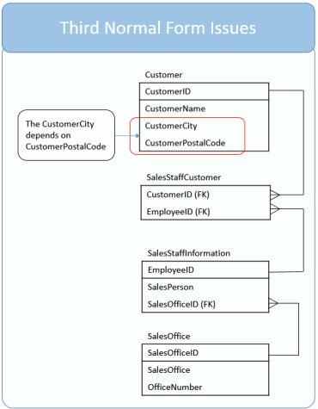
Third Normal Form
CustomerCity relies on CustomerPostalCode which relies on CustomerID
Generally speaking a postal code applies to one city. Although all the columns are dependent on the primary key, CustomerID, there is an opportunity for an update anomaly as you could update the CustomerPostalCode without making a corresponding update to the CustomerCity.
We’ve identified this issue in red.

Slide 18

Third Normal Form
Fix the Model to 3NF Standards
In order for our model to be in third normal form, we need to remove the transitive dependencies. As we stated our dependency is:
CustomerCity relies on CustomerPostalCode which relies on CustomerID
It is OK that CustomerPostalCode relies on CustomerID; however, we break 3NF by including CustomerCity in the table. To fix this we’ll create a new table, PostalCode, which includes PostalCode as the primary key and City as its sole column.
The CustomerPostalCode remains in the customer table. The CustomerPostalCode can then be designated a foreign key. In this way, through the relation, the city and postal code is still known for each customer. In addition, we’ve eliminated the update anomaly.

Slide 19
Third Normal Form
3NF – Third Normal Form Definition
A table is in third normal form if:
A table is in 2nd normal form.
It contains only columns that are non-transitively dependent on the primary key
See next slide for description of transitive, for our purpose it is safe to think “through” as we’ll be reviewing to see how one column in a table may be related to others, through a second column.
An object has a dependence on another object when it relies upon it. In the case of databases, when we say that a column has a dependence on another column, we mean that the value can be derived from the other. For example, my age is dependent on my birthday.
I think it is simplest to think of transitive dependence to mean a column’s value relies upon another column through a second intermediate column.

Slide 20
Third Normal Form
Title | PubID | PageCount | Price
Moby Dick | 1 | 500 | 29.95
Giant | 2 | 500 | 34.95
Moby Dick | 2 | 500 | 34.95

Slide 21
Third Normal Form
Consider the following table scheme and assume, for the purposes of illustration, that no two books with the same title have the same publisher:
Title,PubID,PageCount,Price}
The only key for this table scheme is {Title,PubID}. Both PageCount and Price are informational attributes only.
Now, let us assume that each publisher decides the price of its books based solely on the page count. First, we observe that this table is in second normal form. To see this, consider the proper subsets of the key. These are:
{Title} and {PubID}
But none of the dependencies:
{Title} --> {PageCount}
{Title} --> {Price}
{PubID} --> {PageCount}
{PubID} --> {Price}
hold for this table scheme. After all, knowing the title does not determine the book, since there may be many books of the same title, published by different publishers. Hence, the table is in second normal form.
It is also not correct to say that:
{PageCount} --> {Price}
holds, because different publishers may use different price schemes, based on page count. In other words, one publisher may price books over 1000 pages at one price, whereas another may price books over 1000 pages at a different price. However, it is true that:
{PubID,PageCount} --> {Price}
holds. In other words, here we have an informational attribute (Price) that depends not on a proper subset of a key, but on a proper subset of a key (PubID) together with another informational attribute (PageCount).
This is bad, since it may produce redundancy. For instance, consider Table 4-3. Note that the price attribute is redundant. After all, we could fill in the Price value for the third row if it were blank, because we know that PubID 2 charges $34.95 for 500-page books.

